Slide 1
Workforce Insights & Attrition Risk Assessment
Supporting Growth Through Data-Driven People Strategy
Ankita Yadav

Slide 2
Workforce Overview & Attrition Context
Business Context
CEO concern: Turnover impacting growth
No standardized reporting (new HRIS)
Objective –
Identify concentration of attrition
Understand structural drivers
Distinguish controllable vs external
Workforce Snapshot
Total Employees ~1,470
Attrition Rate ~16%
Largest Department – R&D
Majority Workforce – Job Levels 1–2
Age Concentration – 26–42

Slide 3
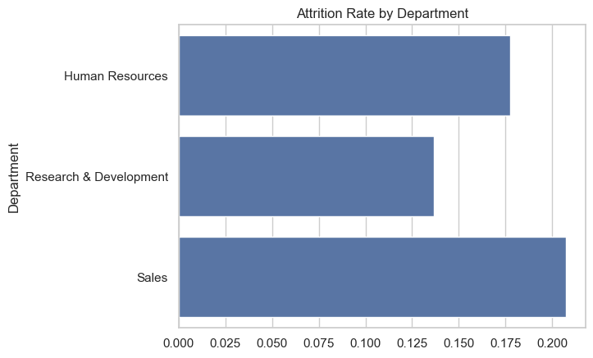
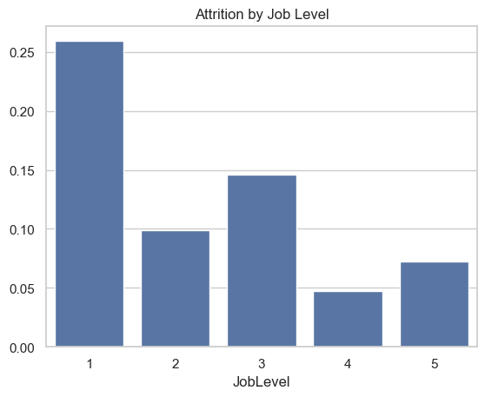
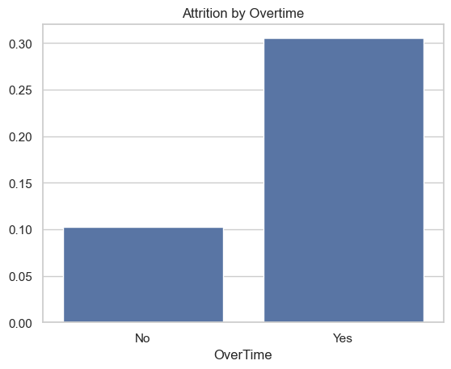
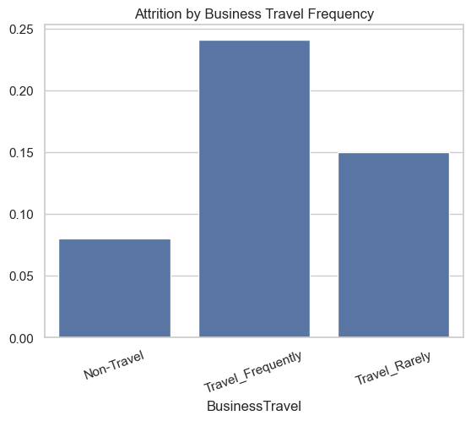
Attrition Is Structurally Concentrated

Slide 4
Predictive Model Performance
Drivers Increasing Risk
Drivers Reducing Risk
Attrition Is Predictable – Key Risk Drivers
ROC-AUC ≈ 0.80
Identifies ~64% of at-risk employees
Stable across validation
Attrition risk is structurally predictable.
Overtime
Frequent Business Travel
Sales roles
Single marital status
Early tenure
Overtime nearly doubles attrition odds.
R&D roles
Higher job & environment satisfaction
Longer tenure in role
Manager stability
Stock options

Slide 5
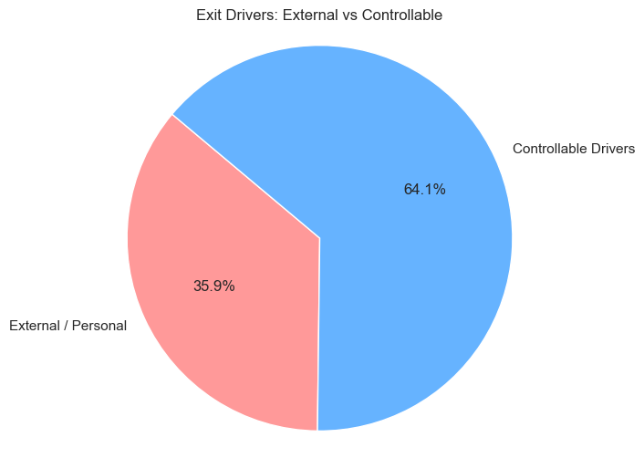
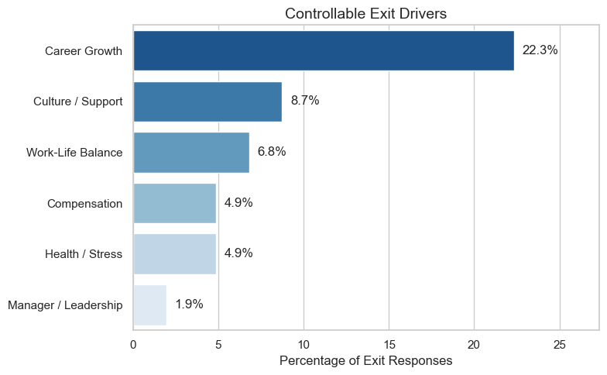
Exit Feedback Validates Structural Drivers
External vs Controllable Attrition
Projected audience for new product or service
$0M
$0M
$0M
$0M
$0M
Under External–
Relocation , Family, Health, Entrepreneurship, Career switch
Note : Not all attrition is organizationally controllable.
Notes:
Under External:
Relocation
Family
Health
Entrepreneurship
Career switch
Note : Not all attrition is organizationally controllable.

Slide 6
Strengthen Career
Pathways
Reduce Workload Intensity & Travel Pressure
Strengthen Engagement & Manager Stability
Targeted Retention Strategy – High Impact Levers
Why
Career Growth = #1 controllable driver (22%)
Junior employees most at risk
Actions
Clear promotion timelines for Level 1–2
Transparent internal mobility framework
Structured career conversations at Years 1–3
Impact — Addresses largest controllable attrition driver.
Why
Overtime strongly predicts attrition
Frequent travel increases risk
Work-life balance cited in exits
Actions
Monitor overtime intensity dashboards
Travel optimization in Sales
Expand hybrid/remote flexibility where feasible
Impact — Reduces structural burnout risk.
Why
Higher satisfaction reduces the probability of attrition.
YearsWithCurrManager reduces risk
Culture cited in exits
Actions
Early-tenure engagement check-ins
Manager capability development
Retention risk flagging system
Impact — Improves retention in Years 1–5 window

